Slide 1

PRICE PERFORMANCE PREDICTION Investment Insights: Analyzing MSFT and JPM within S&P 500 Framework
PROF. : Dr. Chaojie (Jay) Wang
Presented By :
Shivaramakrishna Reddy
MPS, Data Science
MG67053

Slide 2
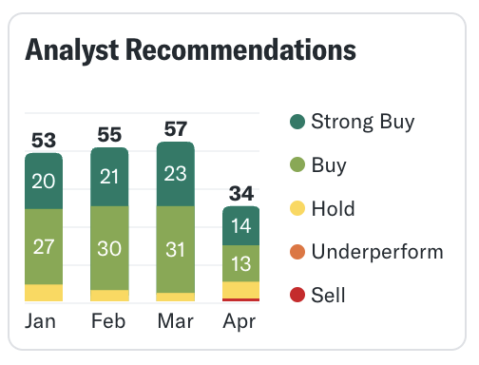
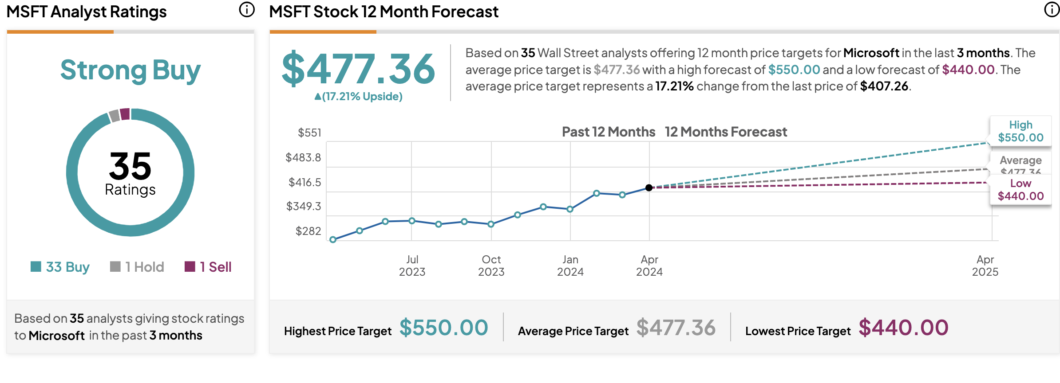
W and H?????

Slide 3
Introduction:
Stock price prediction is a crucial aspect of financial markets, playing a pivotal role for investors, traders, and financial institutions. The ability to forecast stock prices helps stakeholders make informed decisions, optimize investment strategies, and manage risks effectively.
Understanding potential future price movements allows investors to implement effective risk management strategies.
Investors heavily depend on accurate stock price predictions to inform their decisions on buying, selling, or holding assets. These predictions play a crucial role in maximizing returns and minimizing losses, empowering investors to strategically navigate the dynamic financial market landscape.

Slide 4
Dataset:
Dataset source : Yahoo Finance (S&P 500 (^GSPC)),MICROSOFT(MSFT) AND JP MORGAN (JPM) historical Data For Past 10 years
Link: https://finance.yahoo.com/quote/%5EGSPC/history?period1=1550188800&period2=1707955200&interval=1d&filter=history&frequency=1d&includeAdjustedClose=true
Size : 25 - 65 MB
Rows: 2516(All files together)
Columns:6

Slide 5
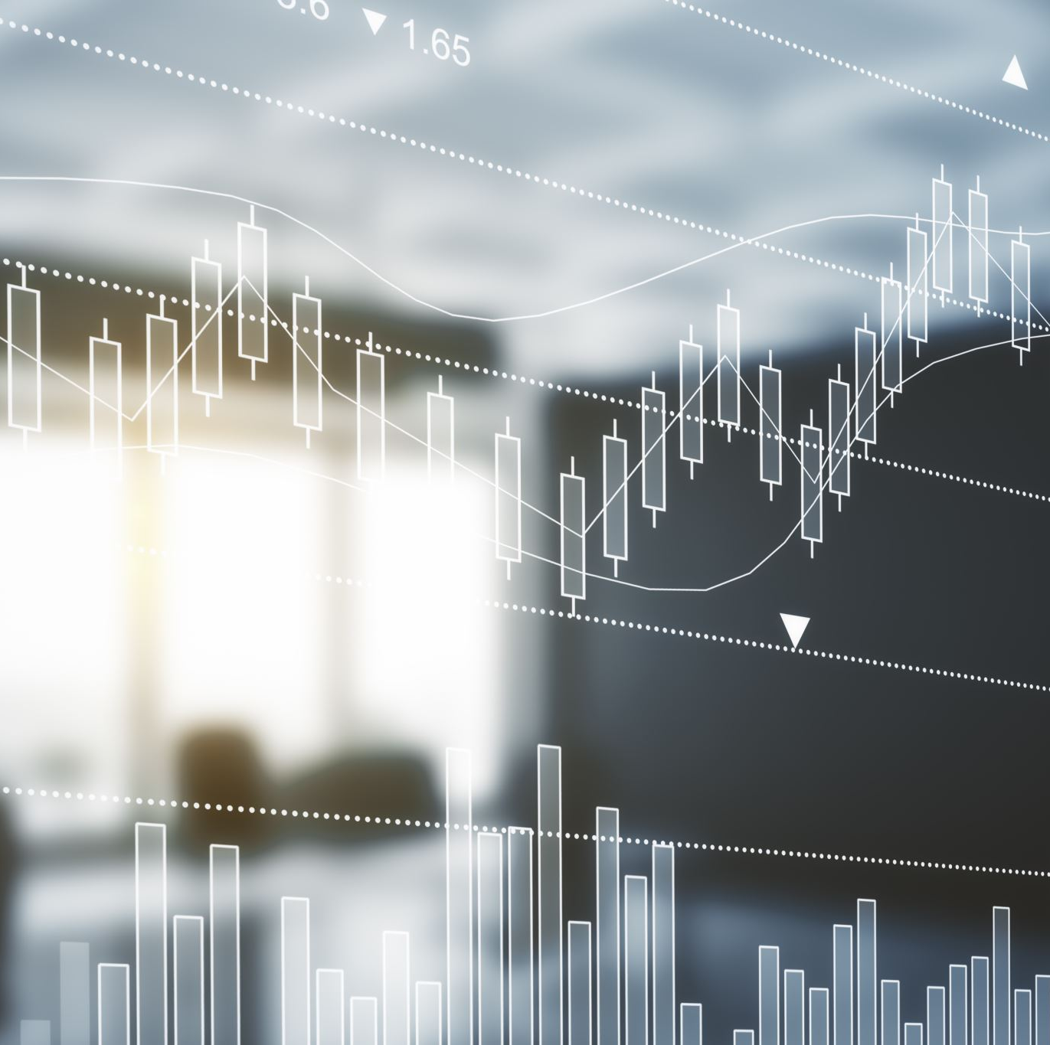
Data Preprocessing
Handled missing values using various techniques like replacing by average value of column
Casting data type
Created new features with existing features
Identified and removed outliers using visualization techniques

Slide 6

Streamlit:
Streamlit is an open-source Python library that makes it easy to create and share beautiful, custom web apps for machine learning and data science
It helps in the project to create a web page and communicate with model for prediction

Slide 7
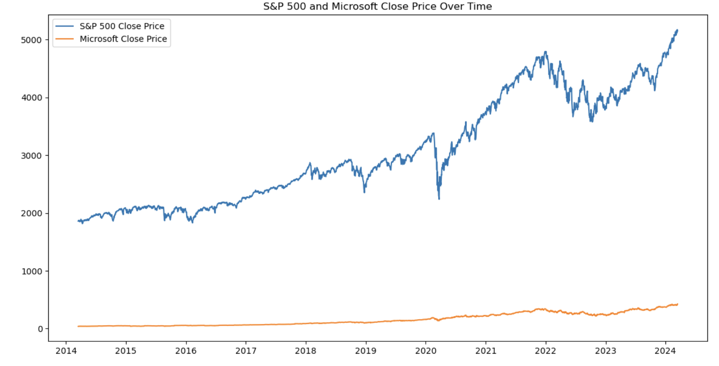
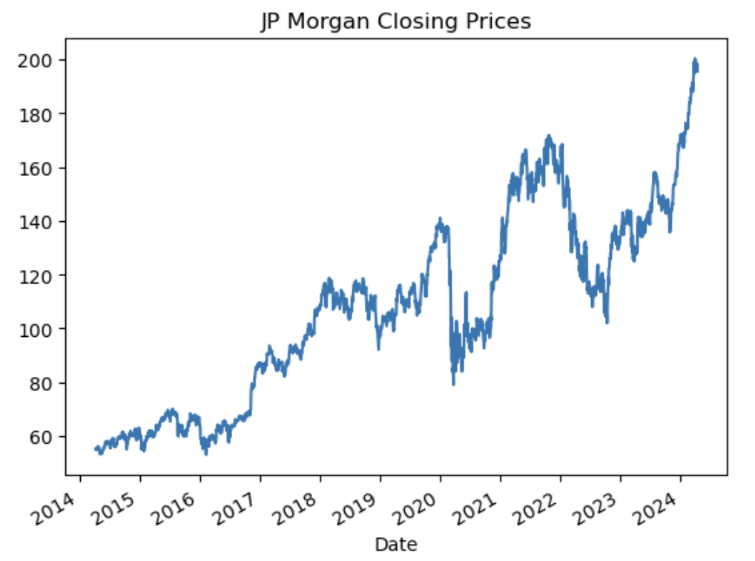
Correlation between S&P 500 and Microsoft Close Prices: 0.9836098248252457 Correlation between S&P 500 and JP MORGAN Close Prices : 0.738979 Correlation in the context of stocks is a statistical measure that describes the extent to which two stock prices move in relation to each other. It's expressed as a correlation coefficient, ranging from -1 to +1(+1 indicates a perfect positive correlation, -1 indicates a perfect negative correlation

Slide 8
BETA CALCULATION:
Beta is a measure of the volatility / a portfolio in comparison to the market as a whole
Beta coefficient (MSFT): 1.206482667843786 Beta coefficient (JPM) : 1.124455652040986
Beta = 1: A beta of 1 indicates that the stock's price tends to move with the market. If the market goes up by 1%, the stock is also expected to go up by 1%, and vice versa.
Beta > 1: A beta greater than 1 indicates that the stock is more volatile than the market, if the beta is 1.2, the stock is expected to increase by 1.2% for every 1% increase in the market.
Beta < 1: A beta less than 1 means that the stock is less volatile than the market

Slide 9
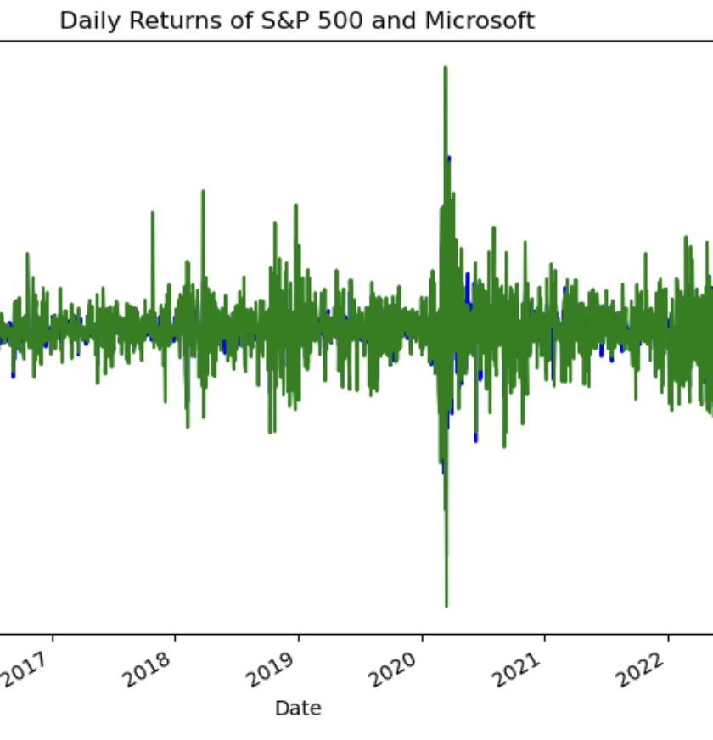
Sharpe Ratio:
The Sharpe Ratio is a widely used metric in finance to evaluate the performance of an investment or portfolio. It measures the risk-adjusted return, indicating how much excess return an investment generates per unit of risk taken
S&P 500 Sharpe Ratio: 0.03256515707370
Microsoft Sharpe Ratio: 0.06186600620133
Sharpe Ratio for JPM: 0.5605262195032
Sharpe Ratio for S&P 500: 0.5169558421365

Slide 10

We Use following Models to Predict and compare the MSFT and JPM with S & P 500
LINEAR REGRESSION
MOVING AVERAGES
ARIMA
RANDOM FOREST REGRESSION
LSTM-Long Short-Term Memory
SVM- Support Vector Machines
Principal Component Analysis (PCA)

Slide 11
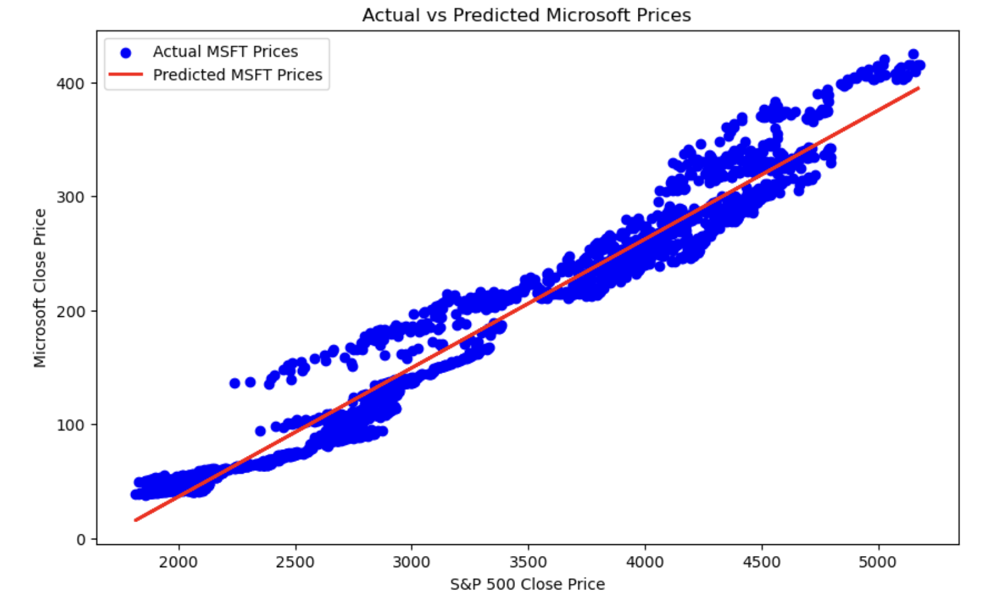
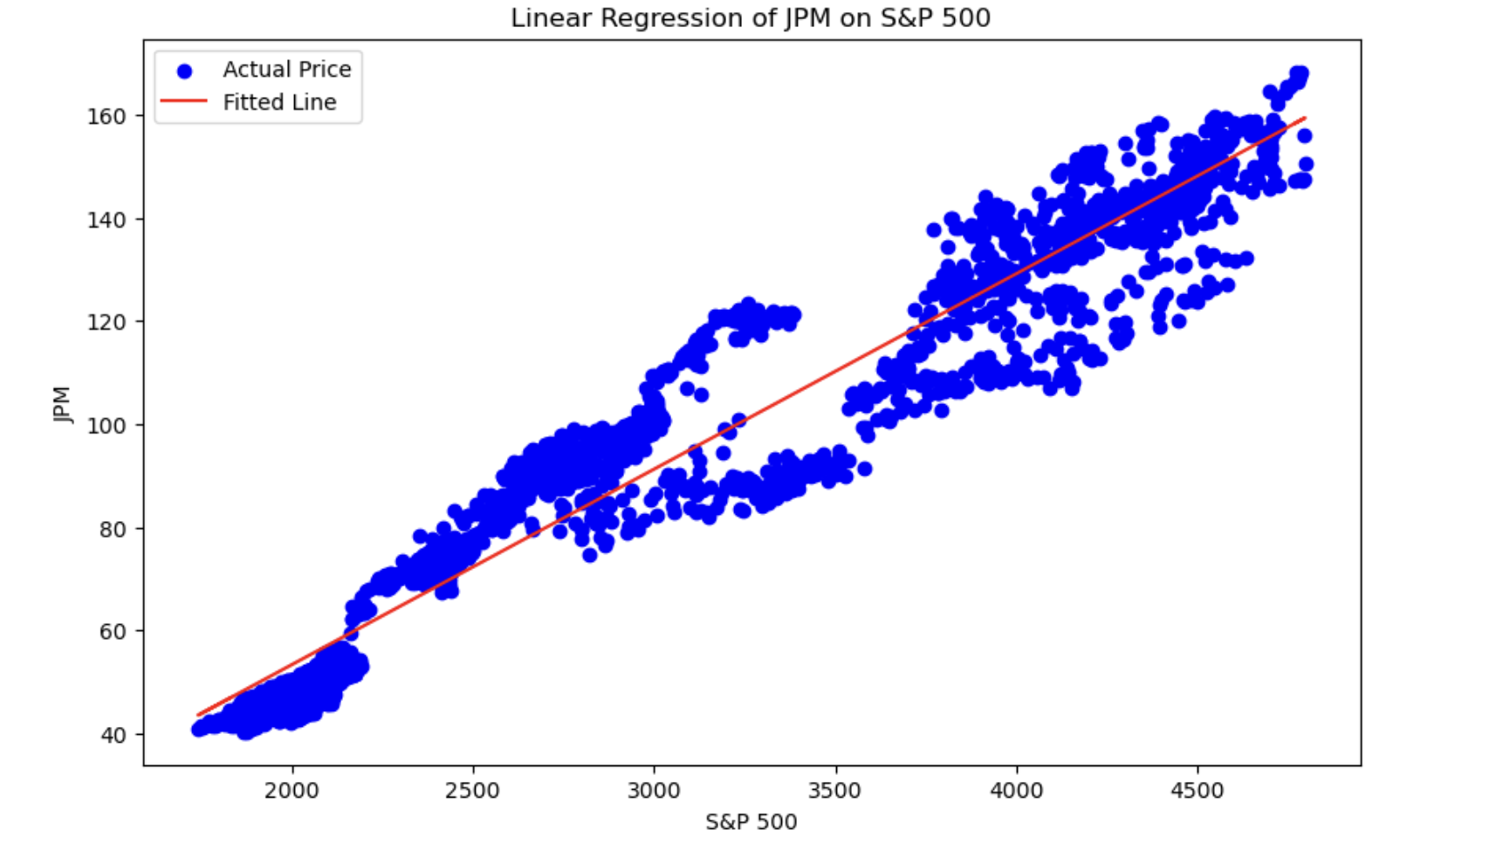
LINEAR REGRESSION:
Useful for understanding the relationship between the dependent variable (like a stock price) and one or more independent variables. It’s simple and provides clear coefficients indicating the impact of each variable.

Slide 12
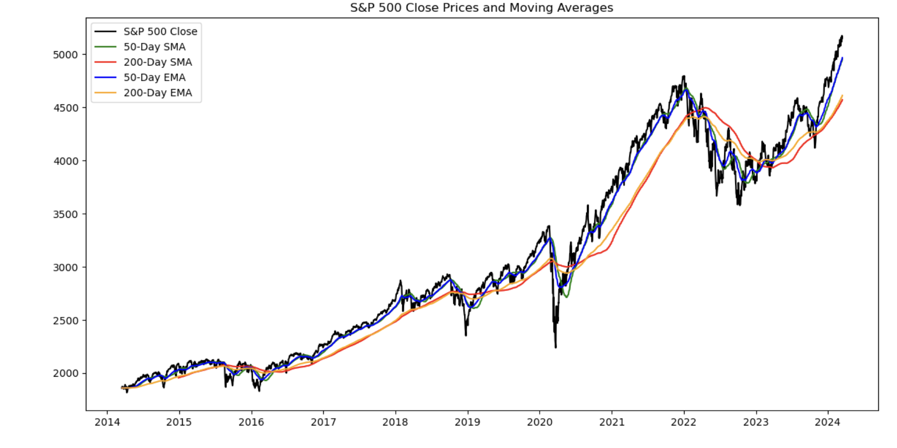
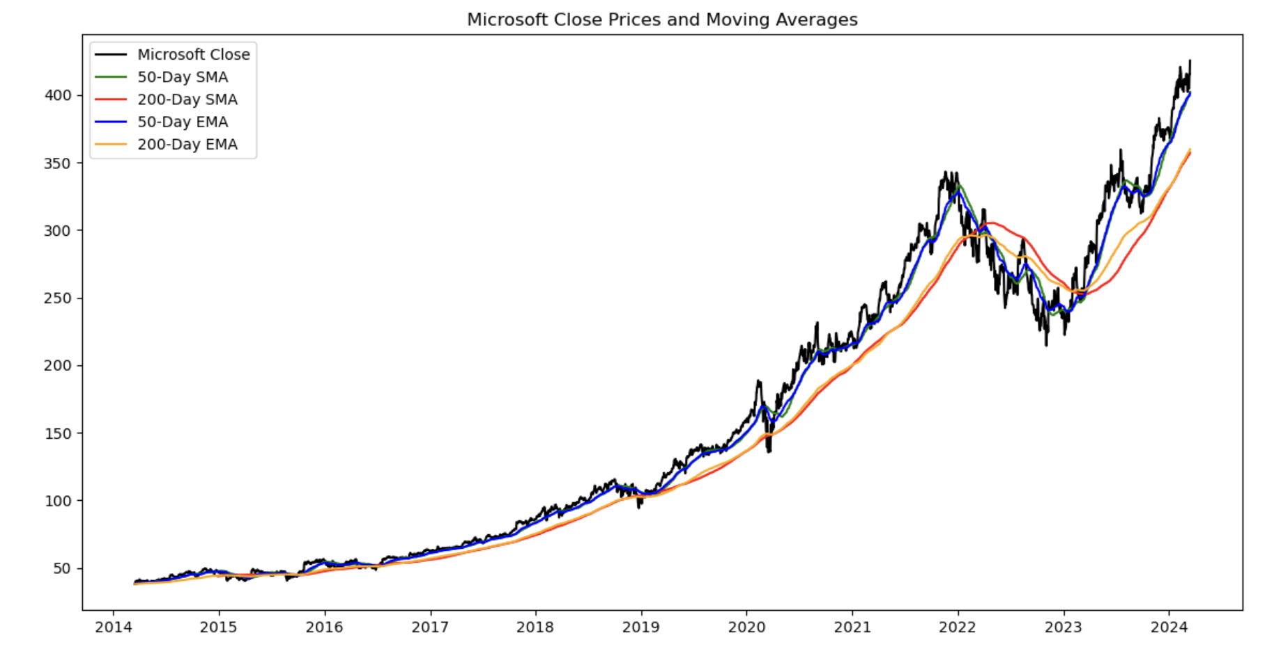
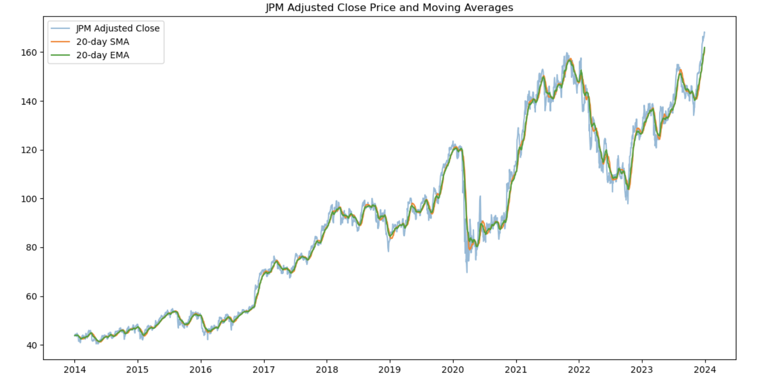
MOVING AVERAGES

Slide 13
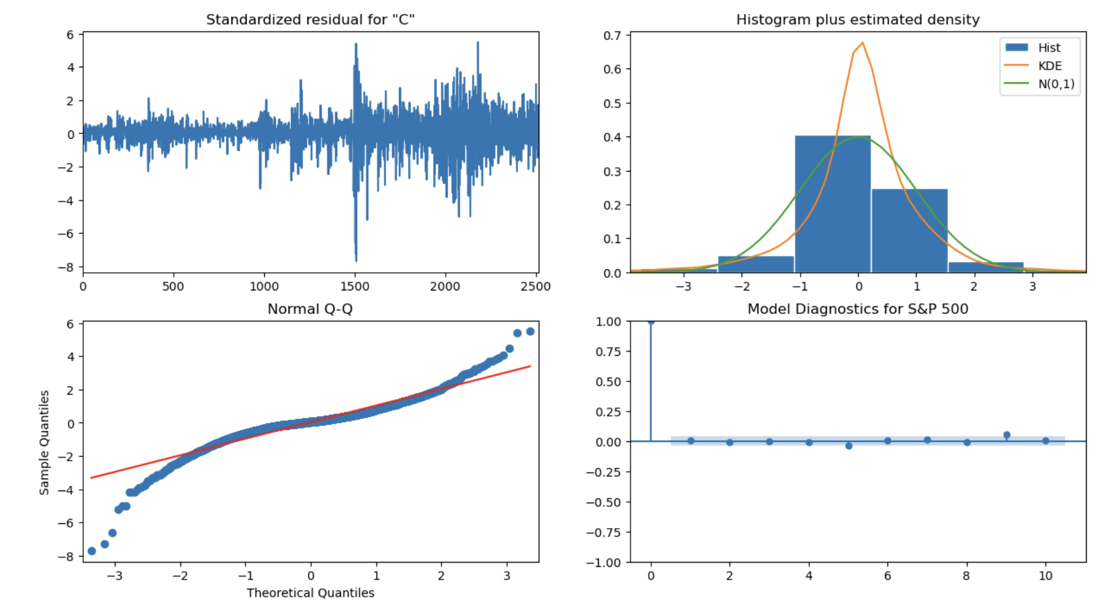
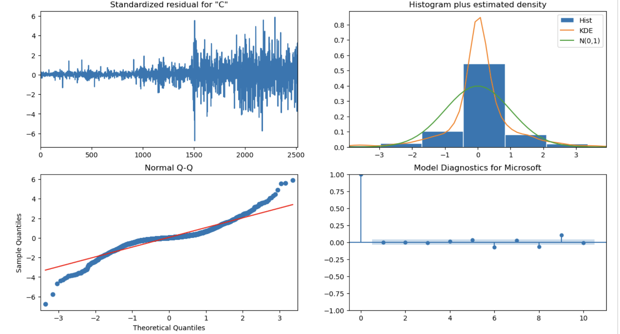
ARIMA(Autoregressive Integrated Moving Average)
Good for forecasting time series data based on its own past values (autoregressive) and a moving average of past forecast errors. It’s particularly useful for non-stationary data

Slide 14
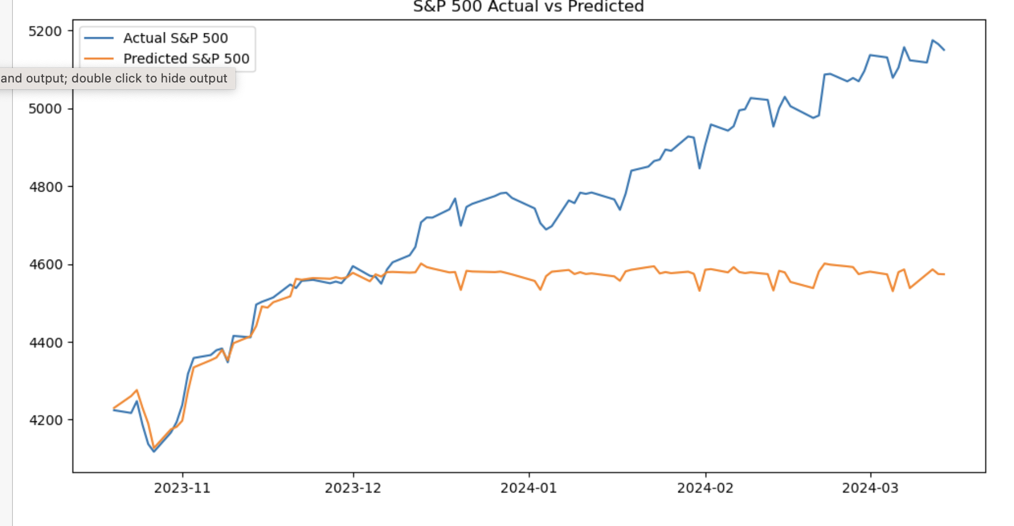
RANDOM FOREST REGRESSION
A type of ensemble learning model that builds multiple decision trees and merges their results to get a more accurate and stable prediction. It’s great for capturing complex, non-linear relationships.

Slide 15
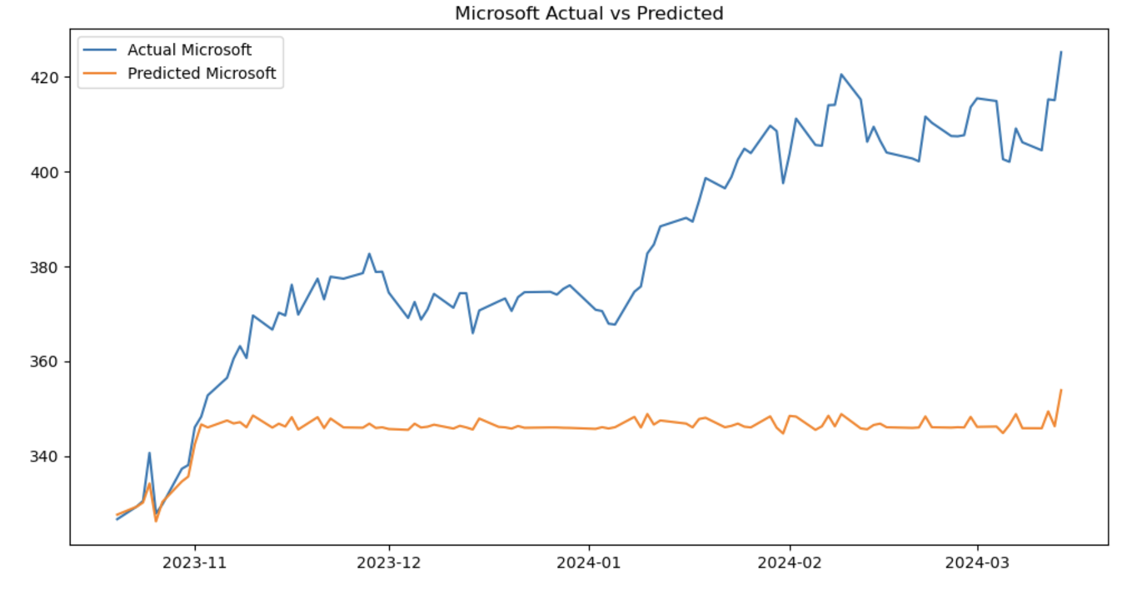
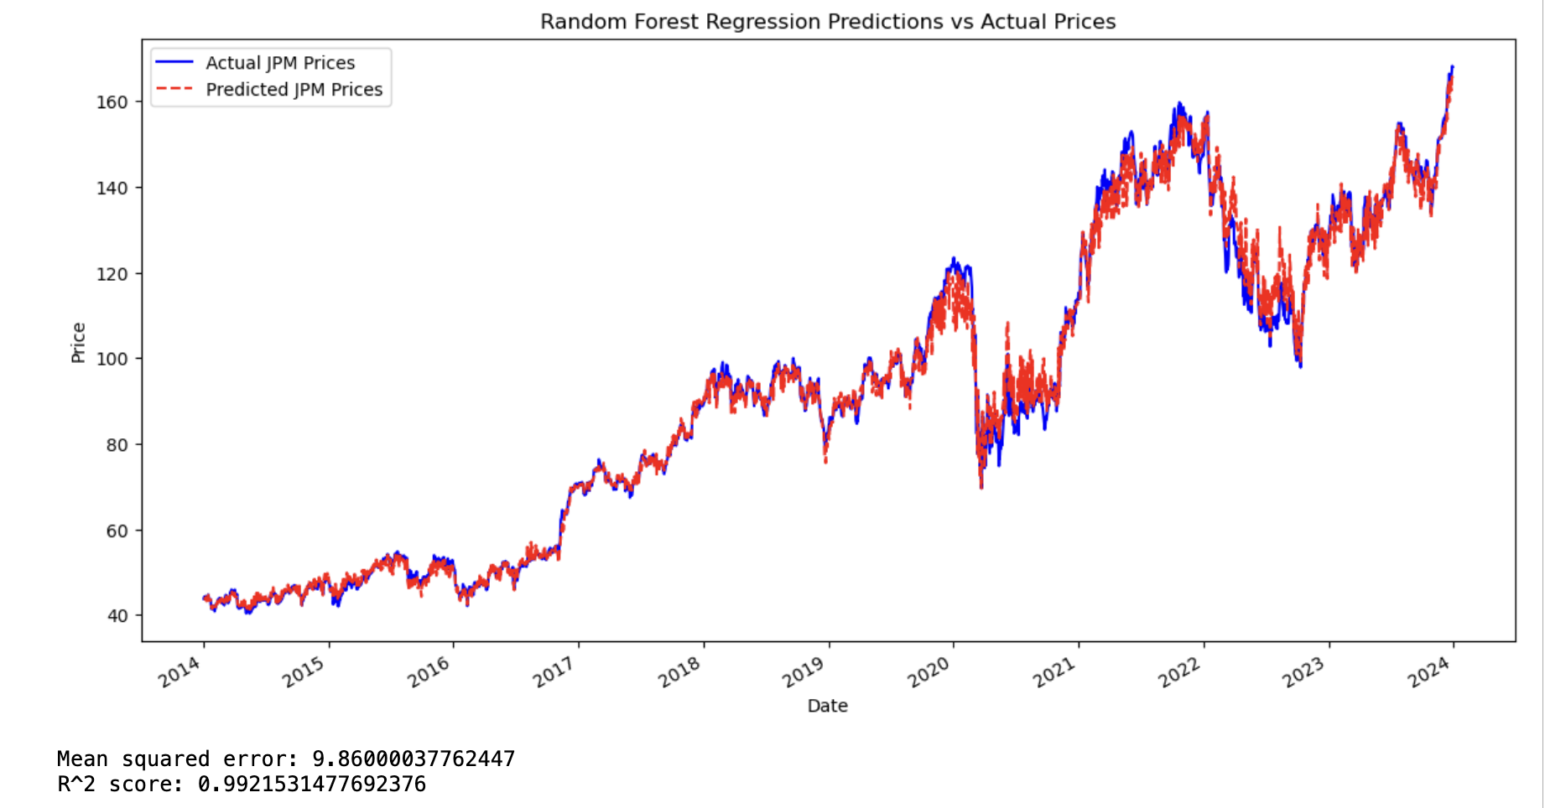

Slide 16
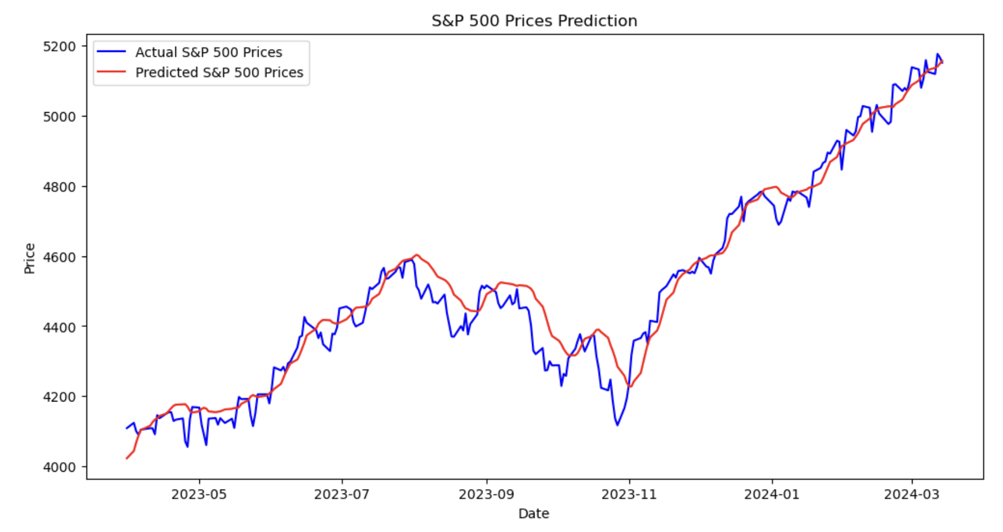
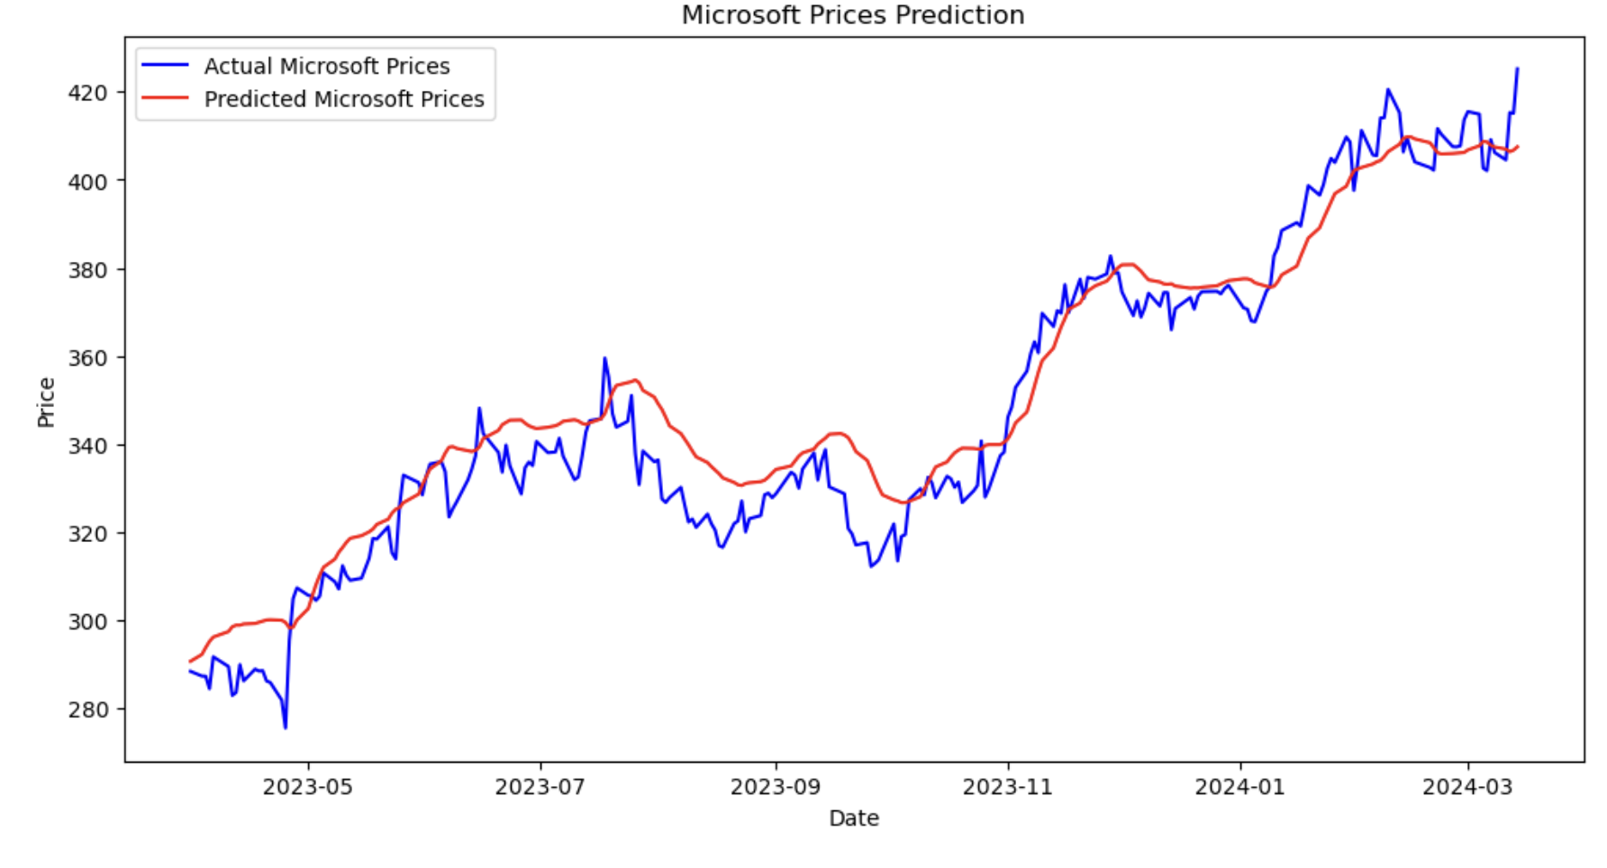
LSTM-Long Short-Term Memory

Slide 17
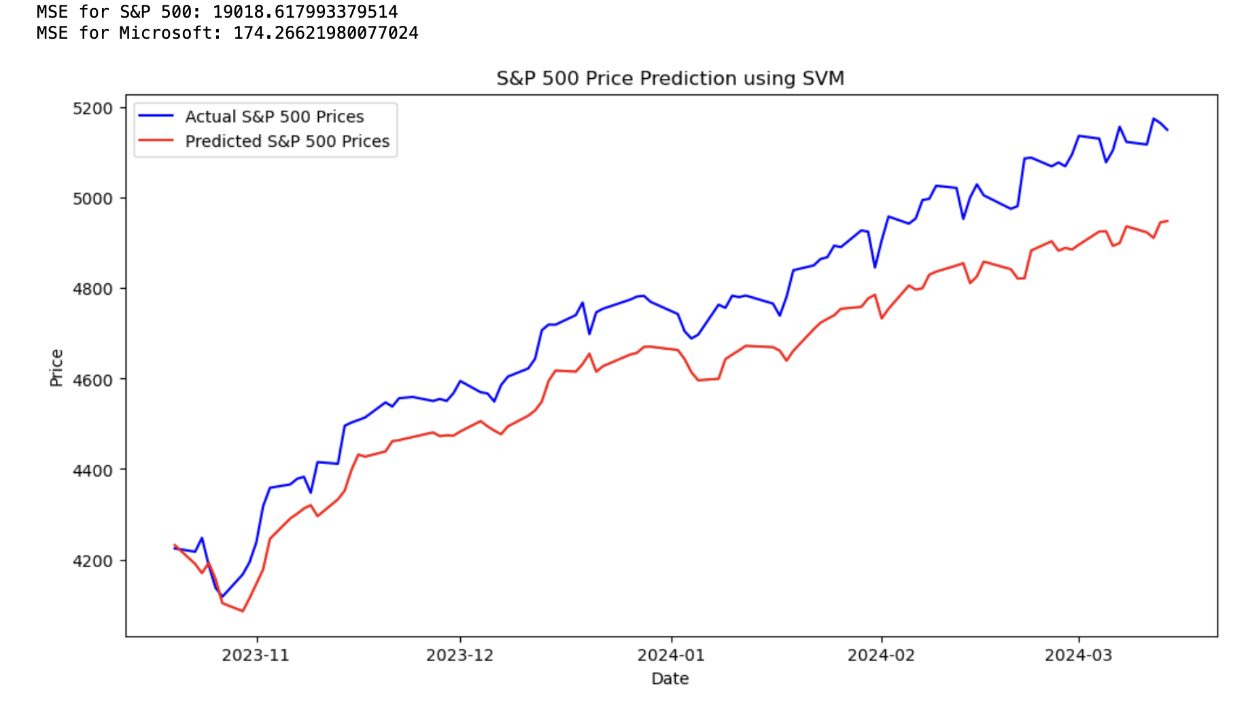
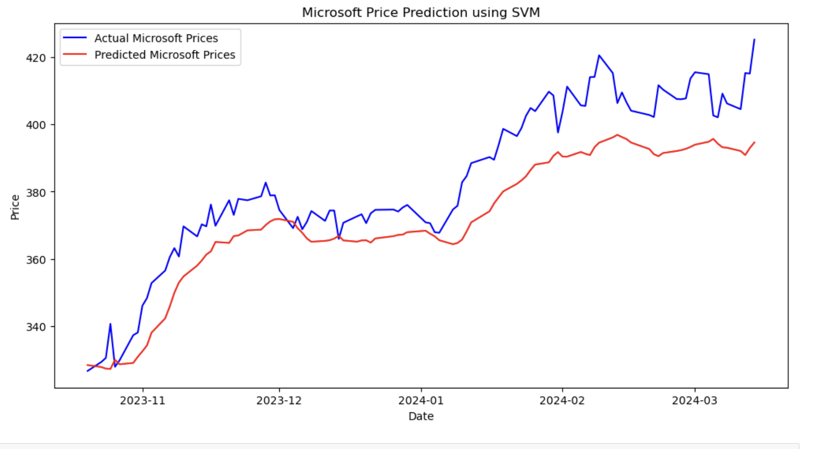
SVM- Support Vector Machines
Originally designed for classification, but can be used in regression (SVR). It works well with non-linear relationships and can model complex relationships between the dependent variable and independent variables

Slide 18
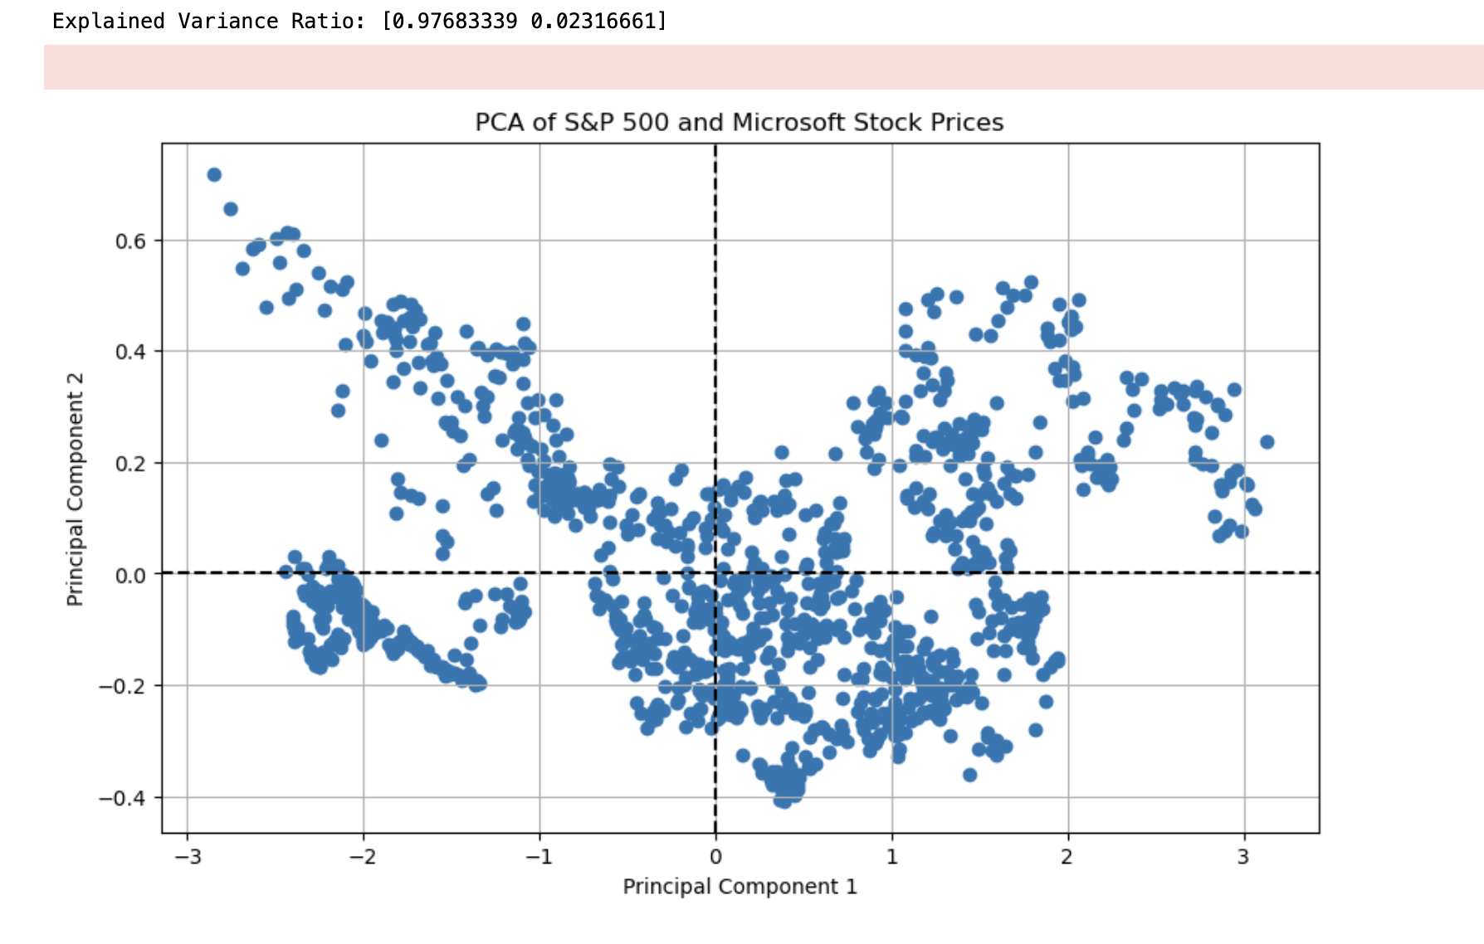
Principal Component Analysis (PCA)
Dimensionality reduction technique. It’s useful for simplifying the dataset, reducing noise, and identifying the most important variables that explain variability in your data, which can improve the performance of other models.

Slide 19
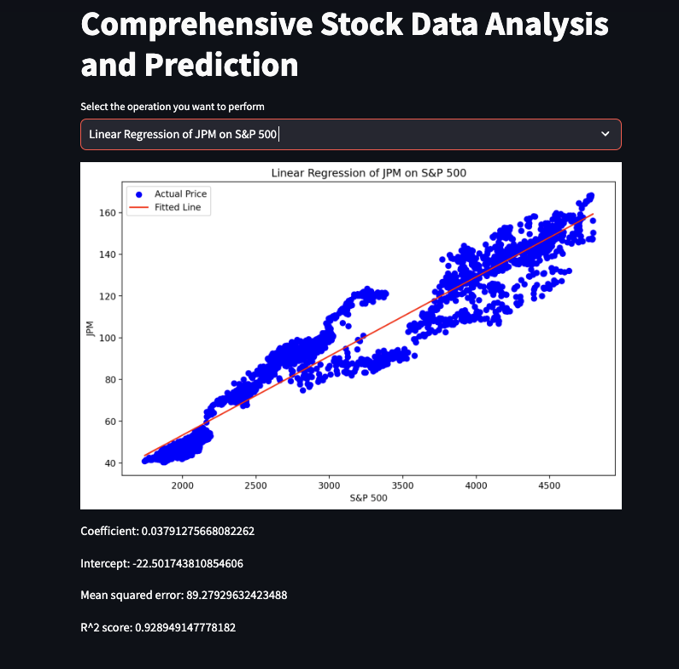
Streamlit Application:

Slide 20
Analysis Summary:
Correlation: Microsoft shows a higher correlation with the S&P 500, indicating movements more aligned with the overall market, which could provide predictability in market trends.
Beta: Microsoft's higher Beta suggests it is more volatile, offering potentially higher risks and returns.
Sharpe Ratio: J.P. Morgan boasts a higher Sharpe Ratio, indicating superior risk-adjusted returns compared to Microsoft.
Conclusion:
J.P. Morgan (JPM) is preferred for better risk-adjusted returns as per the Sharpe Ratio, but Microsoft might appeal to those seeking alignment with broader market movements.

Slide 21
Benefits:
In financial data science and the stock market, these models can help:
Forecast future stock prices or movements.
Understand factors influencing price changes.
Estimate the risk or volatility.
Optimize investment portfolios.
Detect and capitalize on market inefficiencies.
Conduct algorithmic trading.

Slide 22

Thank You

